Slide 1
Propel GO
A new gaming experience to Propel Students

Slide 2
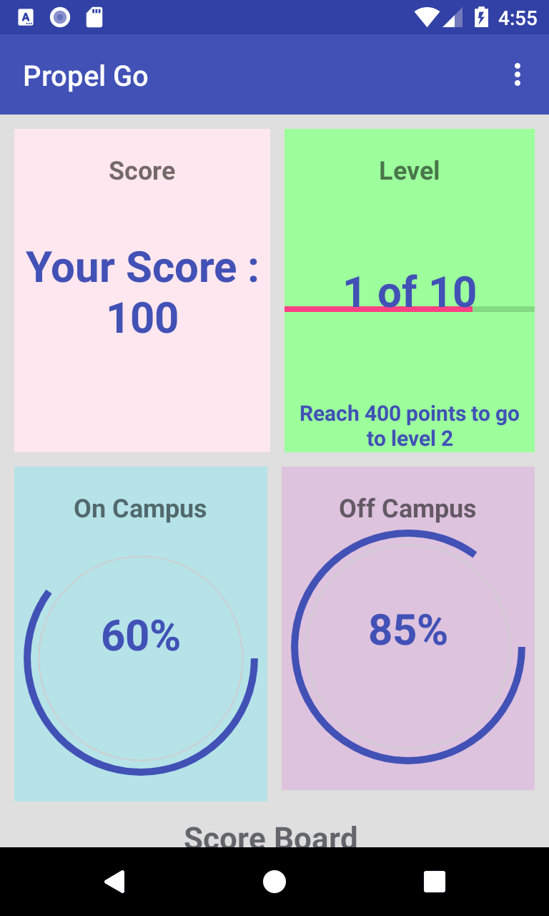


Functional Requirement
To make use of augmented reality and develop a game that encourages students to engage with campus life and with their communities which includes On-Campus Activities and Off-Campus Activities

Slide 3
Objectives:
Students should be using the library, gym, eating in the cafeteria, going to Mind Body Connection, or going to talks, plays, or sporting events etc. which are On-Campus activities
Students must be able to register their participation for Off-Campus activities like Volunteering, taking the bus, working, applying for jobs etc. by taking a photo and submitting.
Goal: Use the game to prompt them for productive things to do on campus and Off Campus

Slide 4
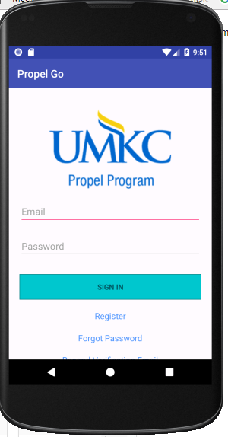
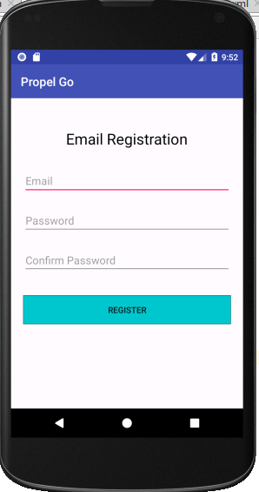
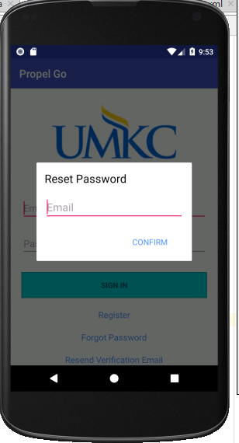
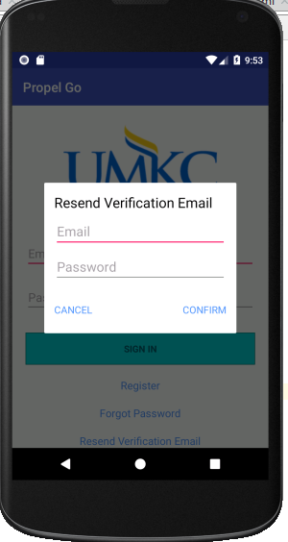
Registration and Login

Slide 5
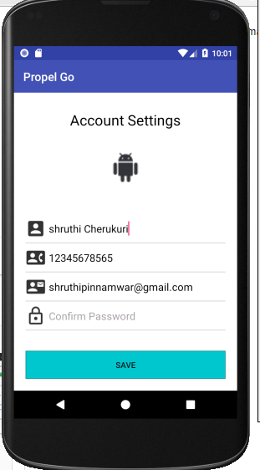
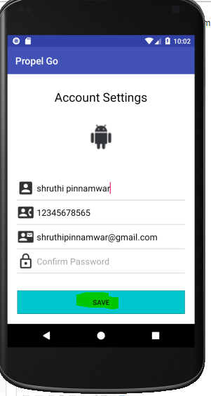
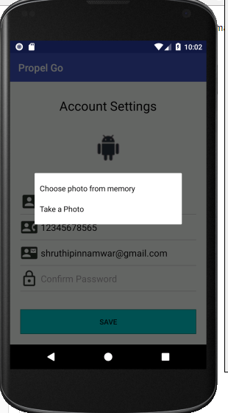
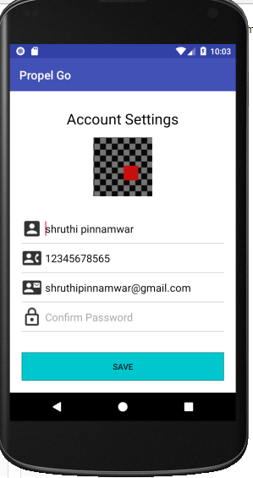
Account Settings

Slide 6
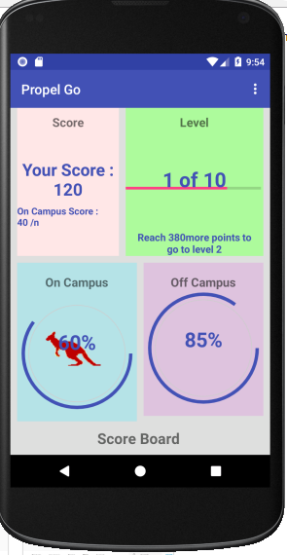
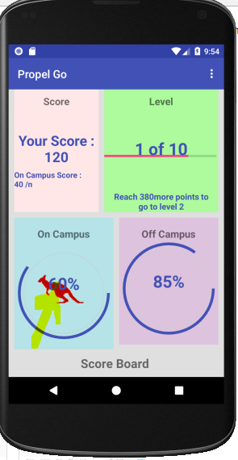
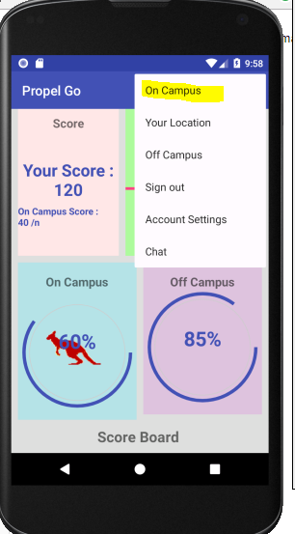
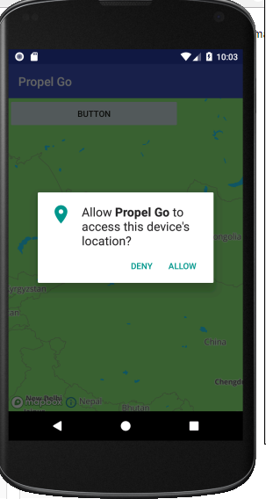
On Campus Activities

Slide 7
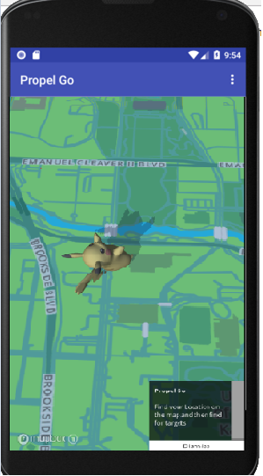
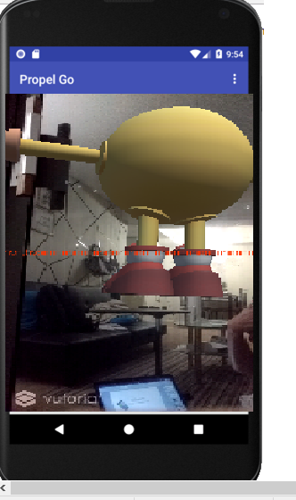

Slide 8
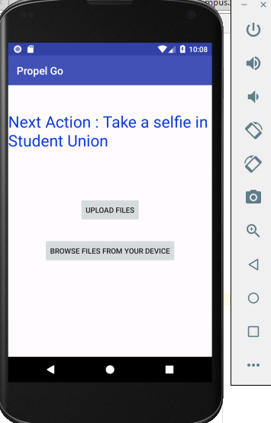
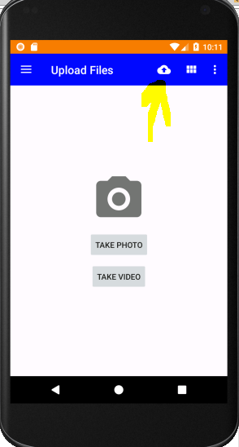
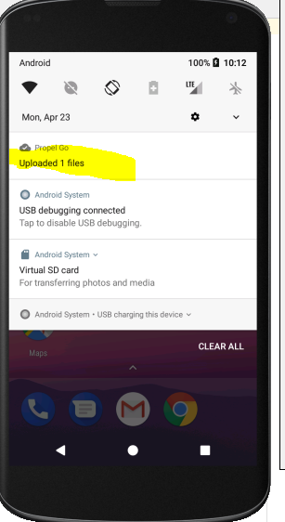
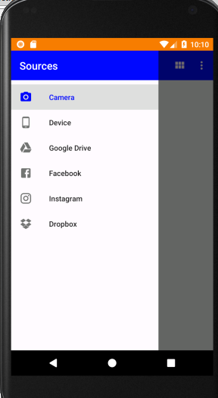
Off Campus Activities

Slide 9
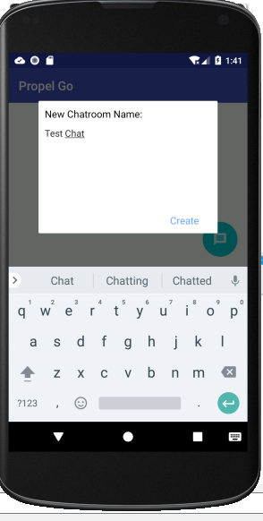
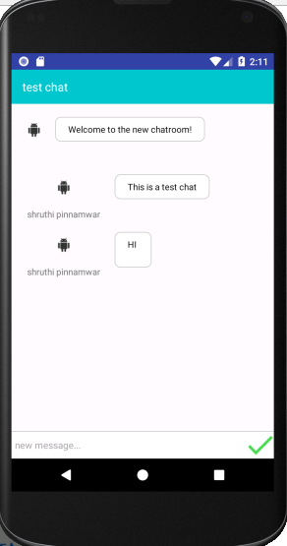
Chatroom

Slide 10
Thank You

